Slide 1


Slide 2
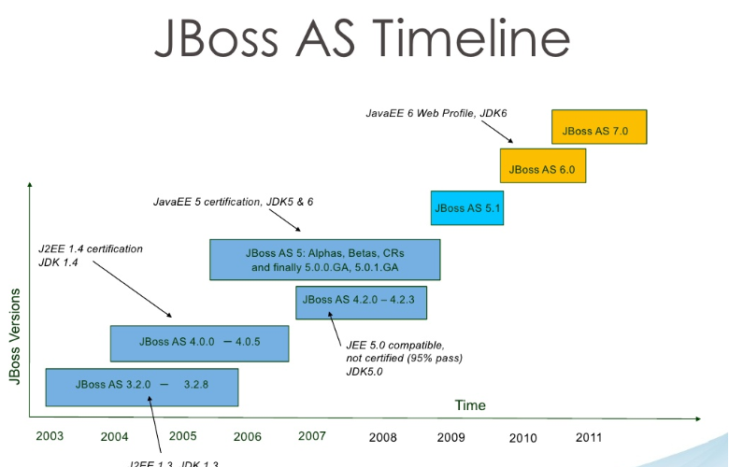

Slide 3
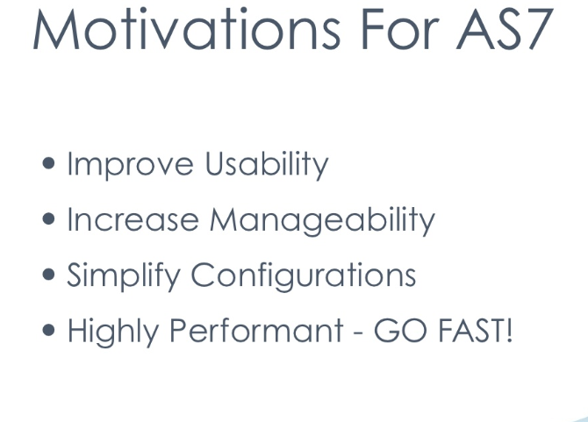

Slide 4


Slide 5
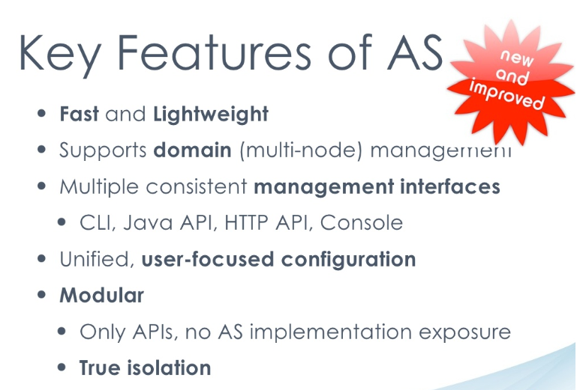

Slide 6
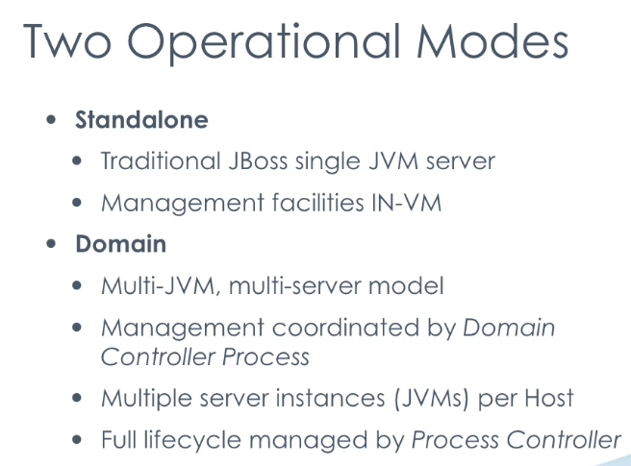

Slide 7
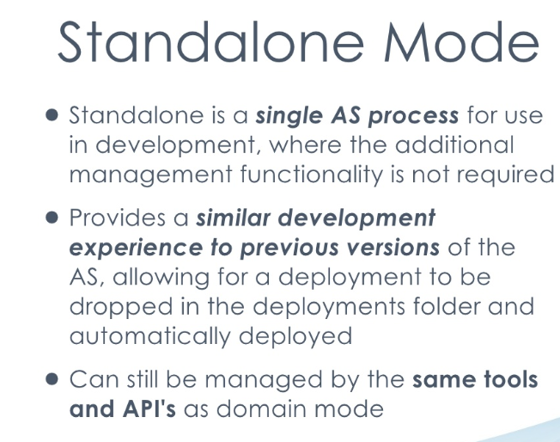

Slide 8
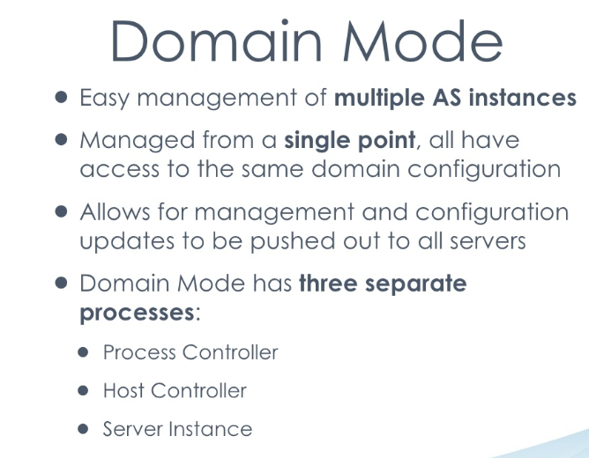

Slide 9
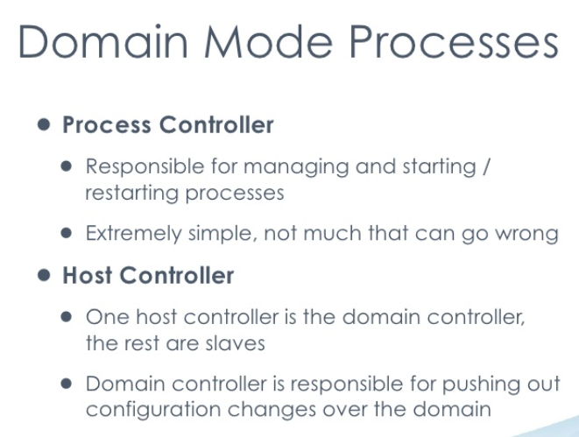

Slide 10
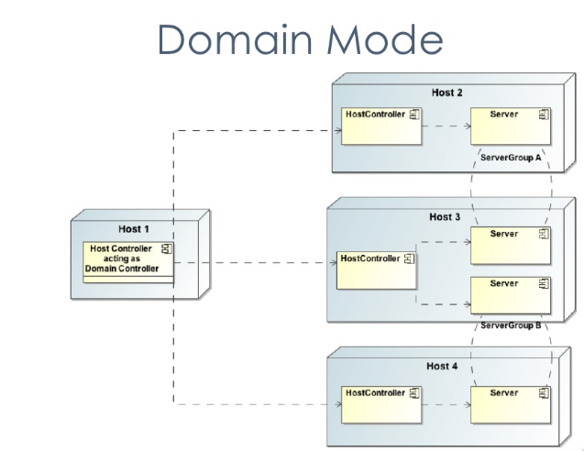

Slide 11


Slide 12
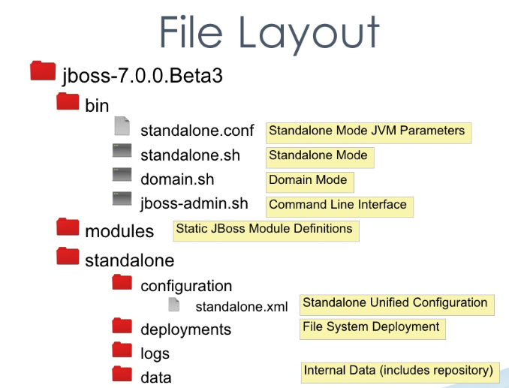

Slide 13
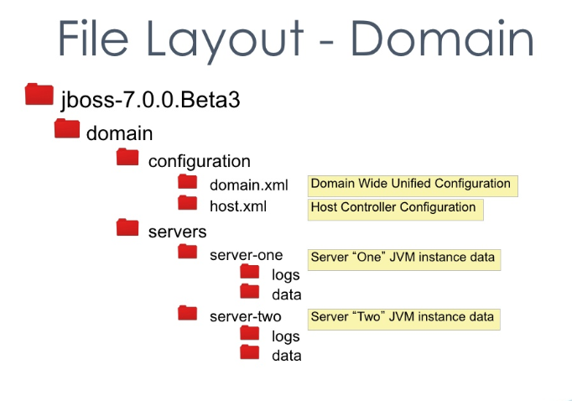

Slide 14
Architecture

Slide 15
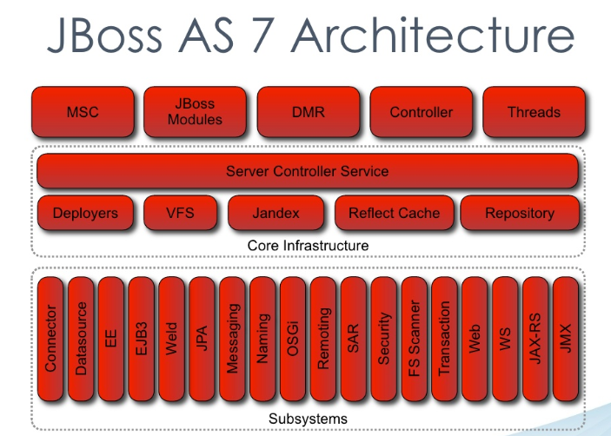

Slide 16


Slide 17
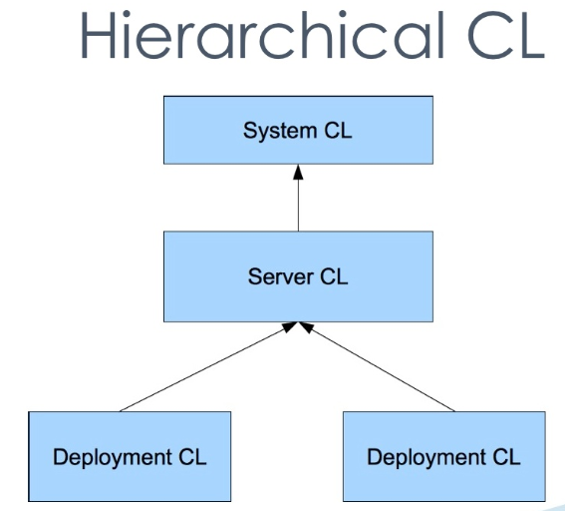

Slide 18
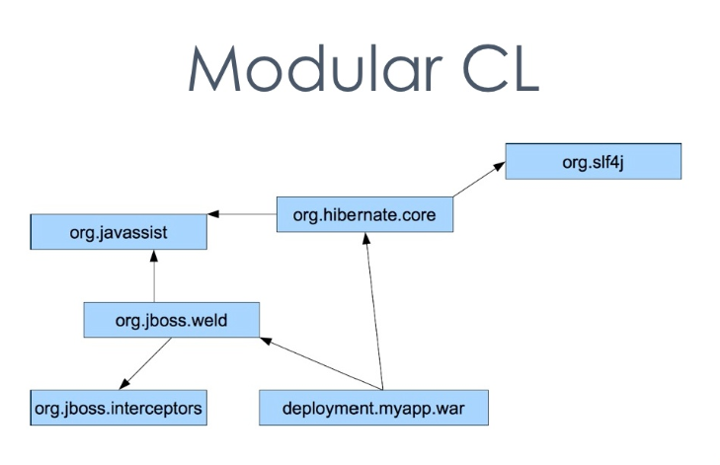

Slide 19


Slide 20
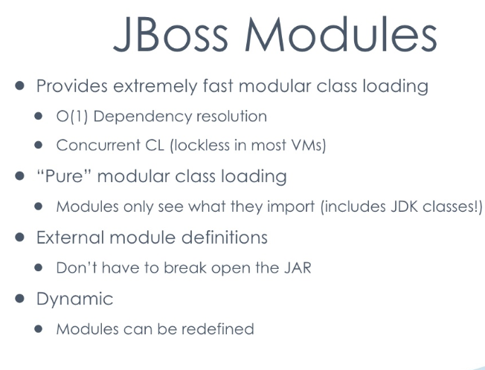

Slide 21
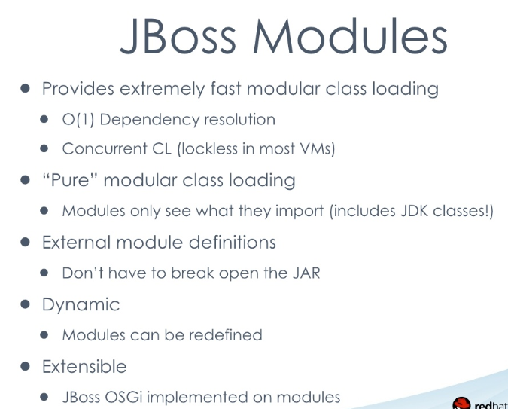

Slide 22
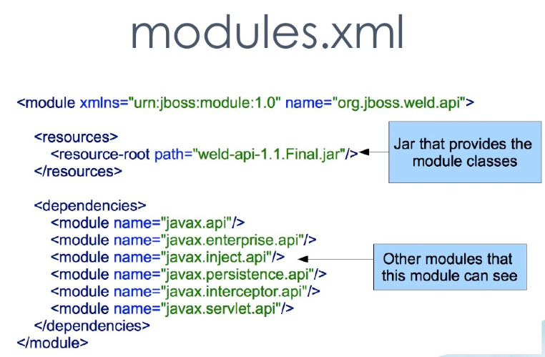

Slide 23
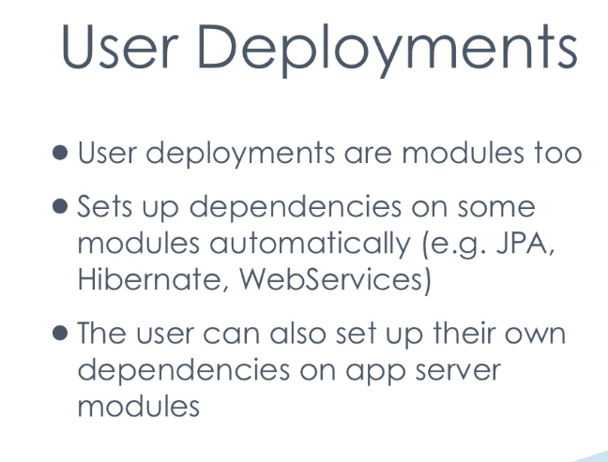

Slide 24
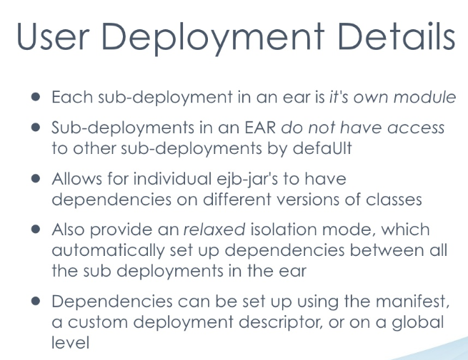

Slide 25


Slide 26
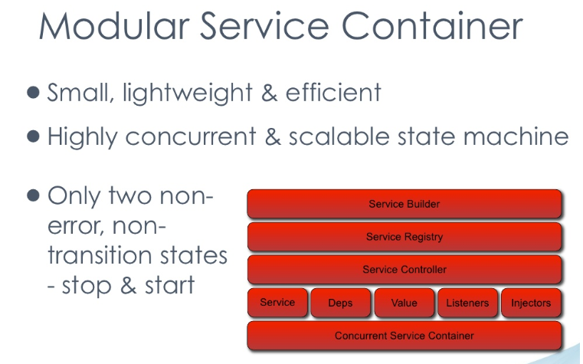

Slide 27
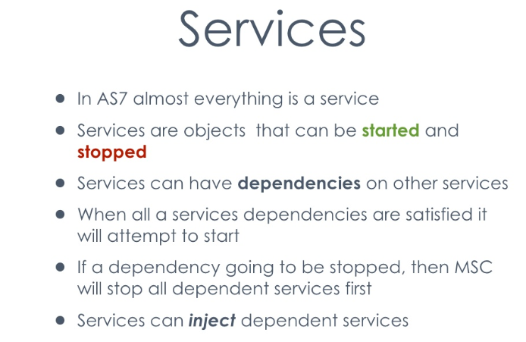

Slide 28
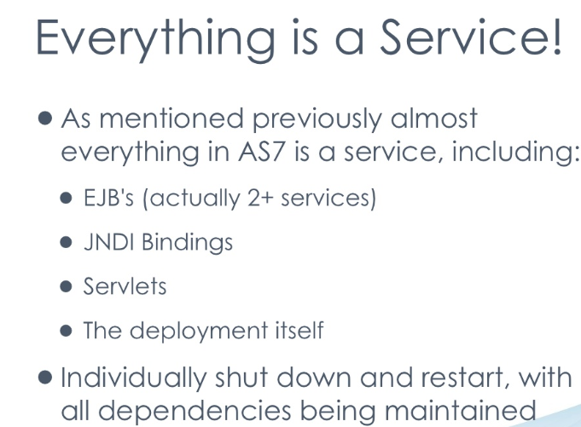

Slide 29
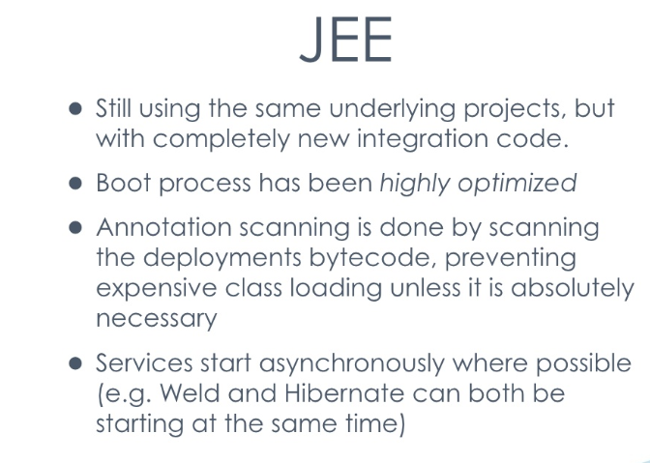

Slide 30


Slide 31
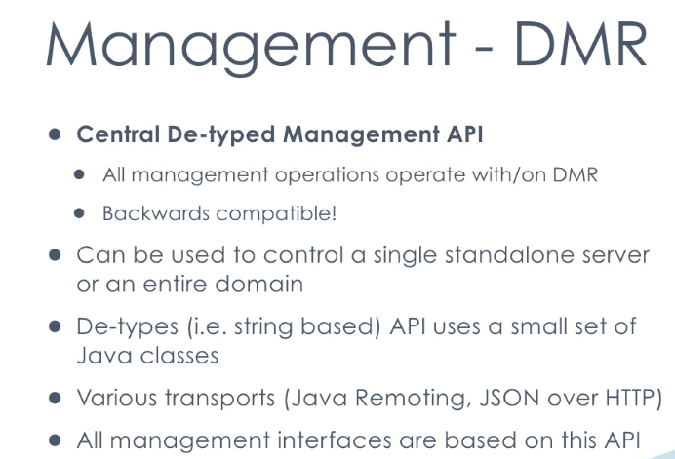

Slide 32
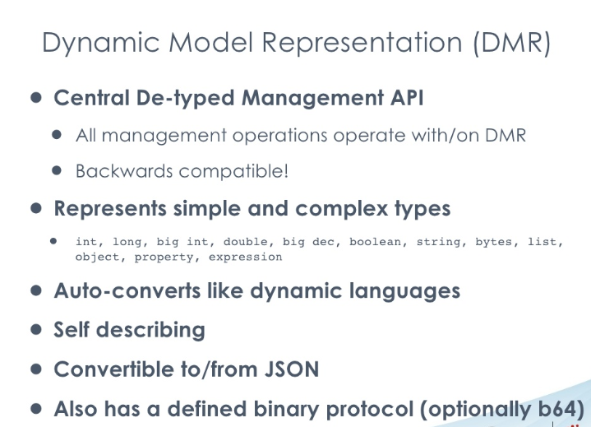

Slide 33
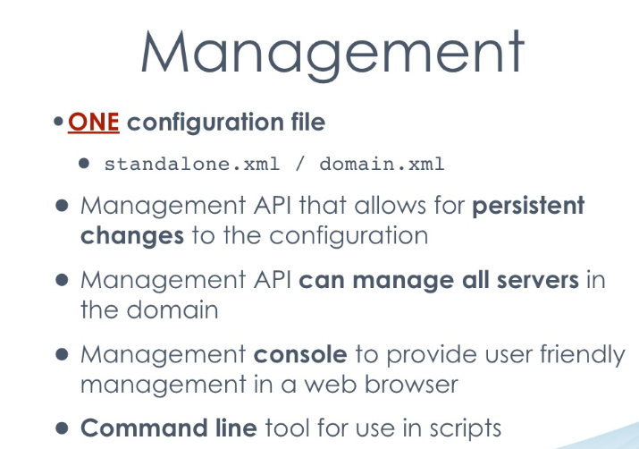

Slide 34
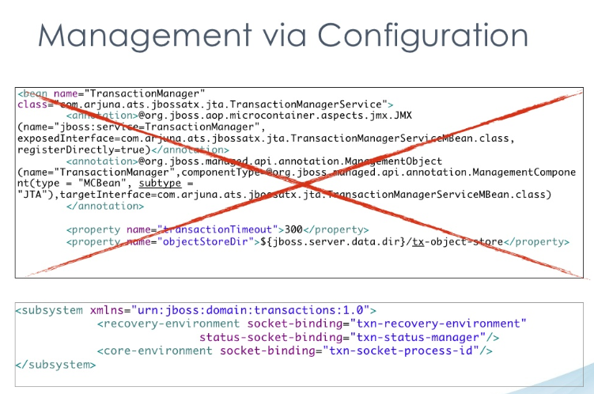

Slide 35
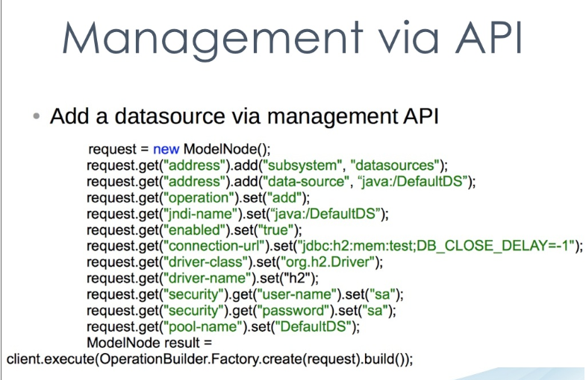

Slide 36
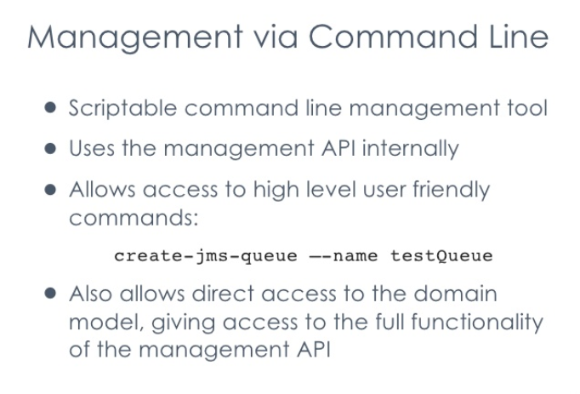

Slide 37
JBoss AS 7.1.1
Configuring Application Server

Slide 38
Server Configuration
Jboss As 7.x works in two modes:
Standalone Mode
Domain Mode

Slide 39
Standalone Configuration

Slide 40
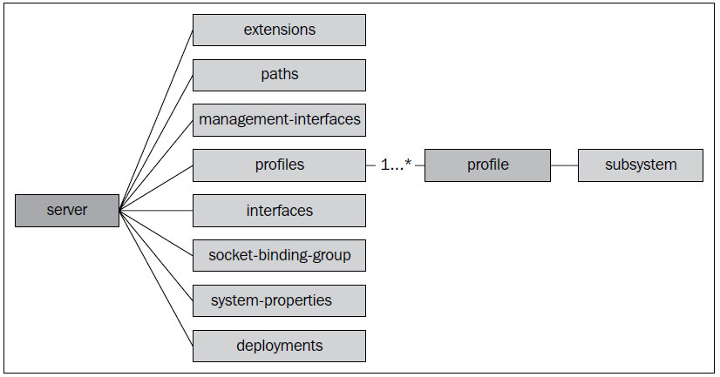
Server Configuration Elements

Slide 41
Extensions
The application server contains a list of basic modules, called extensions, which are shared by all of its services.
they are stored in the JBOSS_HOME/modules folder. Each extension is in turn picked up by the AS classloader at boot time, before any deployment.
most of the capabilities people associate with an application server are provided via extensions.
The user indicates that they want a particular extension to be available by including an <extension/> element naming its module in the domain.xml or standalone.xml file.

Slide 42
Extensions
<extensions>
[...]
<extension module="org.jboss.as.transactions"/>
<extension module="org.jboss.as.web" />
<extension module="org.jboss.as.webservices" />
<extension module="org.jboss.as.weld" />
</extensions>

Slide 43
Paths
They are logical names for file system paths.
E.g. AS log directory named log.dir, which translates for standalone servers into JBOSS_HOME/standalone/log/mylogdir
<paths>
<path name="log.dir" path="mylogdir" relative-to= "jboss.server.log.dir"/>
</paths>

Slide 44
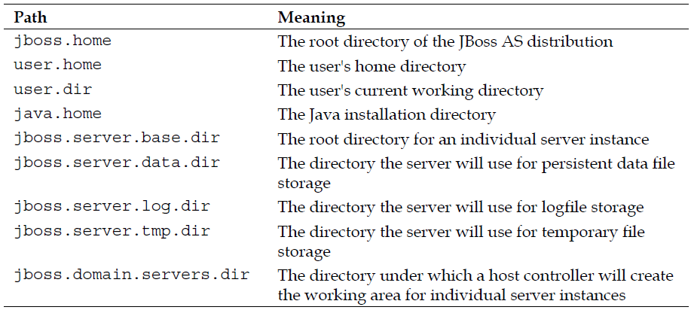
Paths
system paths that are available for use as relative paths and cannot be overridden by the user:

Slide 45
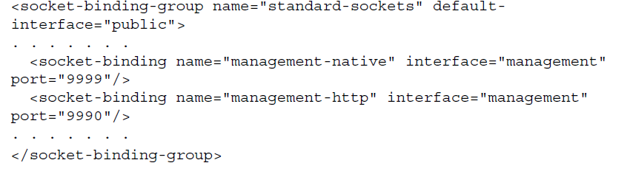
Management interfaces
Administration and management channels.

Slide 46
Profiles
One of the core concepts introduced in AS.
A profile can be seen as a collection of subsystems: each subsystem in turn contains a subset of functionalities used by the application server.
For example, the web subsystem contains the definition of a set of connectors used by the container, the messaging subsystem defines the JMS configuration and modules used by the AS's messaging provider, and so on.

Slide 47
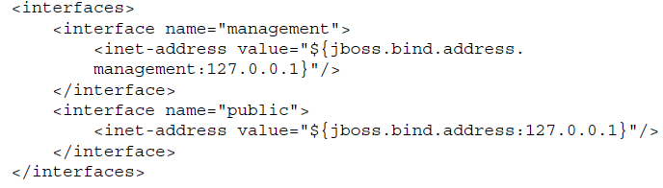
Interfaces
contains the network interfaces/IP addresses or host names where the application server can be bound.
By default, the standalone application server defines two available network interfaces
the management and the public interface.

Slide 48
Interfaces
The public network interface is intended to be used for the application server core services.
The management network interface is referenced by the AS management interfaces.

Slide 49
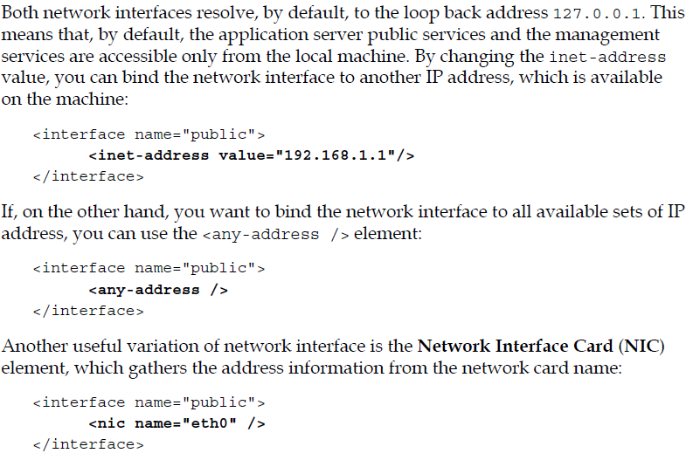
Interfaces

Slide 50
Socket binding groups
A socket binding makes up a named configuration of a socket.
Within this section, you are able to configure the network ports, which will be open and listening for incoming connections.
Every socket binding group references a network interface through the default-interface attribute .

Slide 51
Socket binding groups -- Example
<socket-binding-group name="standard-sockets" default-interface="public">
<socket-binding name="jndi" port="1099"/>
<socket-binding name="jmx-connector-registry" port="1090"/>
<socket-binding name="jmx-connector-server" port="1091"/>
<socket-binding name="http" port="8080"/>
<socket-binding name="https" port="8447"/>
<socket-binding name="osgi-http" port="8090"/>
<socket-binding name="remoting" port="4447"/>
<socket-binding name="txn-recovery-environment" port="4712"/>
<socket-binding name="txn-status-manager" port="4713"/>
<socket-binding name="txn-socket-process-id" port="4714"/>
<socket-binding name="messaging" port="5445"/>
<socket-binding name="messaging-throughput" port="5455"/>
</socket-binding-group>

Slide 52
System properties

Slide 53
Deployments
The last section of the configuration file contains the deployed application, which has been registered on the application server.
Each time a new application is deployed or un-deployed, this section is updated to reflect the new application stack.
<deployments>
<deployment name="TestWL.ear" runtime-name="TestWL.ear">
<content sha1="a725f5fdfa0bb04b9842b944ae07ba5ee7eb41a8"/>
</deployment>
<deployment name="TestDataSource1.war"
runtime-name="TestDataSource1.war">
<content sha1="a7ea38c032cbbdedd8c3300d629c7b2cacb4860e"/>
</deployment>
</deployments>

Slide 54
Configuring core subsystems
JBoss Administration

Slide 55
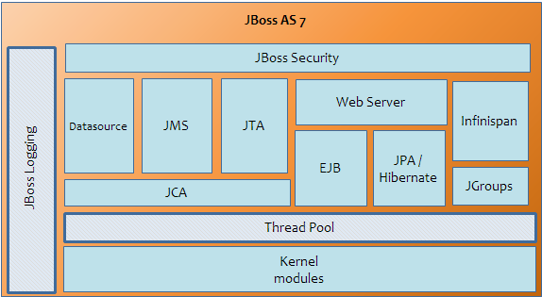
Frequently Configured Subsystems

Slide 56
Configuring the Thread Pool subsystem

Slide 57
Thread Pool Configuration
Thread Pool configuration can include the following elements:
Thread factory configuration
Bounded Threads configuration
Unbounded Threads configuration
Queueless Thread Pool configuration
Scheduled Thread configuration

Slide 58
Configuring the Thread factory
A Thread factory (implementing java.util.concurrent.ThreadFactory) is an object that creates new Threads on demand.
Using Thread factories removes hardwiring of calls to new Thread, enabling applications to use special Thread subclasses, priorities, and so on.
The Thread factory is not included by default in the server configuration as it relies on defaults, which you will hardly need to modify.
Nevertheless, we will provide a sample configuration of it for the experienced user who requires complete control of the Thread configuration.

Slide 59
Example of a custom Thread factory configuration
<thread-factory name="MyThreadFactory"
thread-name-pattern="My Thread %t"
group-name="dummy" />
The name attribute is the name of the created Thread factory.
The optional priority attribute may be used to specify the Thread priority of created Threads.
The optional group-name attribute specifies the name of the Thread group to create for this Thread factory.
The thread-name-pattern is the template used to create names for Threads.

Slide 60
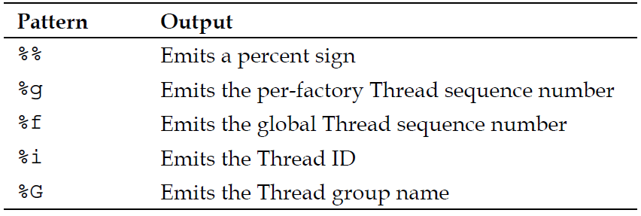
The thread-name-pattern

Slide 61
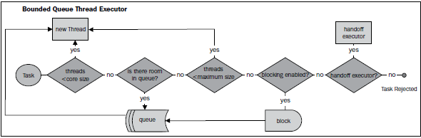
Bounded Thread Pool
<bounded-queue-thread-pool name="jca-short-running"
blocking="true">
<core-threads count="10" per-cpu="20" />
<queue-length count="10" per-cpu="20" />
<max-threads count="10" per-cpu="20" />
<keepalive-time time="10" unit="seconds" />
</bounded-queue-thread-pool>

Slide 62
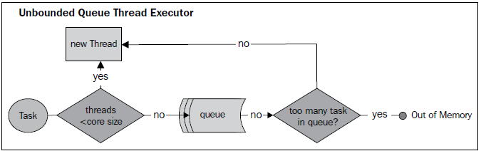
Unbounded Thread Pool
<unbounded-queue-thread-pool name="unbounded-threads">
<max-threads count="10" per-cpu="20" />
<keepalive-time time="10" unit="seconds" />
</unbounded-queue-thread-pool>

Slide 63
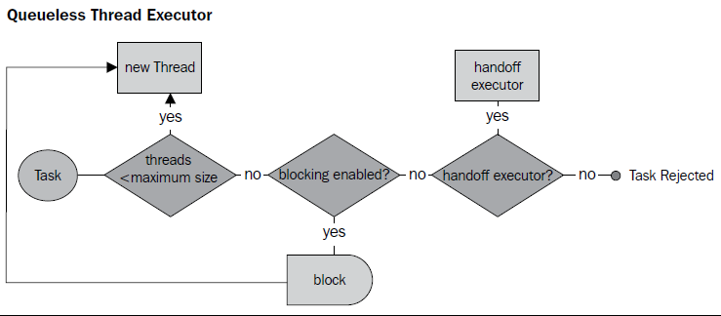
Queueless Thread Pool
<queueless-thread-pool name="queueless-thread-pool" blocking="true">
<max-threads count="10" per-cpu="20"/>
<keepalive-time time="10" unit="seconds"/>
</queueless-thread-pool>

Slide 64
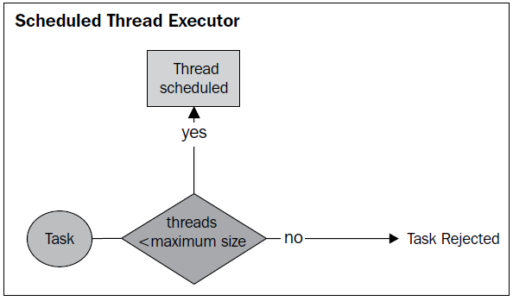
Scheduled Thread Pool
<scheduled-thread-pool name="remoting">
<max-threads count="10" per-cpu="20"/>
<keepalive-time time="10" unit="seconds"/>
</scheduled-thread-pool>

Slide 65
Configuring the application server logging

Slide 69
Configuring Enterprise Services

Slide 70
Enterprise Service Configuration includes the following topics:
Configure the database connectivity
Configure the enterprise Java Bean container
Configure the messaging service
Configure the transaction service

Slide 71
Deployable Datasource using -ds.xml
Deployment of Datasource using -ds.xml was missing from Jboss Version 7 and now it is available again from JBoss AS 7.1.1
Steps
You need a database driver
Can be made available as module
It can be deployed as a deployable unit like other applications
You need to create a <dataosurce_name)-ds.xml and deploy it.

Slide 72
Deploying a JDBC Driver
cp mysql-connector-java-5.1.18-bin.jar /usr/jboss-as-7.1.1.Final/standalone/deployments
The success output would look something like this:
09:32:10,400 INFO [org.jboss.as.server] (DeploymentScanner-threads - 2) JBAS018559: Deploed "mysql-connector-java-5.1.18-bin.jar“

Slide 73
Create and deploy the -dx.xml (e.g. Mysql-ds.xml)
<?xml version="1.0" encoding="UTF-8"?>
<datasources xmlns="http://www.jboss.org/ironjacamar/schema">
<datasource
jndi-name="java:jboss/datasources/employeedb"
enabled="true"
use-java-context="true" pool-name="employeedb">
<connection-url>
jdbc:mysql://localhost:3306/demo
</connection-url>
<driver>mysql</driver>
<pool></pool>
<security>
<user-name>root</user-name>
<password>root</password>
</security>
</datasource>
</datasources>

Slide 74
Drawbacks of -ds.xml deployment
Is there any pitfall when using the older -ds.xml approach ?
Actually we are "bypassing" the management interface and deploy the datasource in the old way.
We will not be able to manage it through the CLI or Web admin interface.
If we check the management console our datasource is not enlisted through the manageable resources of the Web interface.

Slide 75
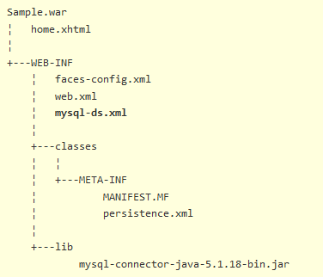
Deploying the datasource along with your application

Slide 76
Deployment
Auto deployment
Deployment using Mgmt console
CLI deployment
Deployment scanner
Exploded Deployment
Deploy in a custom location

Slide 77
Deployment Scanner

Slide 78
Changing the behaviour of Deployment Scanner
The properties that control the auto-deploy feature are auto-deploy-zipped and auto-deployexploded, respectively.
<deployment-scanner scan-interval="5000"
relative-to="jboss.server.base.dir"
path="deployments"
auto-deploy-zipped="true" auto-deploy-exploded="false"/>
You could set the auto-deploy-exploded to true, to achieve automatic redeployment of exploded archives as well:
<deployment-scanner scan-interval="5000"
relative-to="jboss.server.base.dir"
path="deployments"
auto-deploy-zipped="true" auto-deploy-exploded="true"/>

Slide 79
Deploying in a custom Location
<paths>
<path name="as7deployments" path="C:/AS7" />
</paths>
<subsystem xmlns="urn:jboss:domain:deployment-scanner:1.0">
<deployment-scanner name="default" path="deployments" relative-to="as7deployments" scan-enabled="true" scan-interval="5000" deployment-timeout="60"/>
</subsystem>

Slide 80
<paths>
<path name="as7deployments" path="C:/AS7" />
</paths>
<subsystem xmlns="urn:jboss:domain:deployment-scanner:1.0">
<deployment-scanner name="default" path="deployments" relative-to="as7deployments" scan-enabled="true" scan-interval="5000" deployment-timeout="60"/>
</subsystem>

Slide 81
JBoss CLI

Slide 83
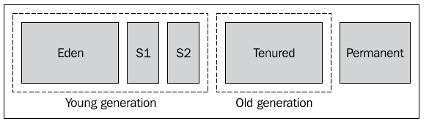

Slide 84
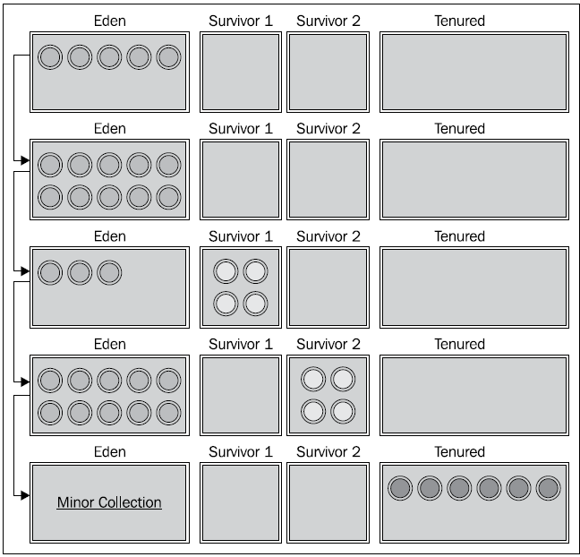

Slide 86
The garbage collector algorithms
Serial collector
Parallel collector
Concurrent collector
since release 1.6.14 of J2SE called the G1 collector

Slide 87
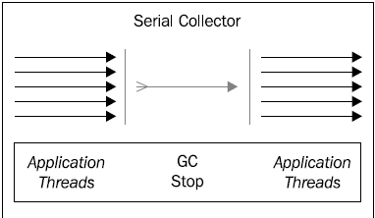
Serial Collector
can be explicitly enabled with the option -XX:+UseSerialGC.

Slide 88
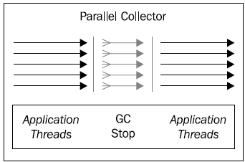
Parallel Collector
can be explicitly enabled with the option -XX:+UseParallelGC.

Slide 89
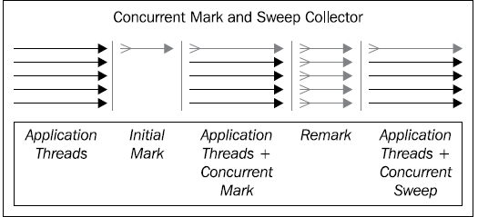
Concurrent collector (CMS)
The concurrent collector is enabled with the
option -XX:+UseConcMarkSweepGC

Slide 90
G1 Collector
The G1 garbage collector has been released in release 1.6 update 14 of Sun's JDK.
The G1 collector is targeted at server environments with multi-core CPU's equipped with large amounts of memory and aims to minimize delays and stop the worldcollections, replacing with concurrent garbage collecting while normal processing is still going on.
In the G1 Garbage collector there is no separation between younger and older regions.
Rather the heap memory is organized into smaller parts called Regions.
Each Region is in turn broken down into 525 byte pieces called cards.

Slide 91
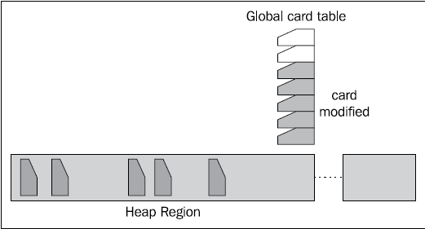
G1 Collector
For each card, there is one entry in the global card table

Slide 92
G1 Collector
For each card, there is one entry in the global card table
This association helps to track which cards are modified (also known as "remembered set"), concentrating its collection and compaction activity first on the areas of the heap that are likely to be full of reclaimable objects, thus improving its efficiency.
G1 uses a pause prediction model to meet user-defined pause time targets.
This helps minimize pauses that occur with the mark and sweep collector, and should show good performance improvements with long running applications.

Slide 93
Enable G1
This collector is still under development.
To enable the G1 garbage collector, add the following switch to your JVM:
java -XX:+UnlockExperimentalVMOptions -XX:+UseG1GC . . .

